Slide 1
WEEK 15

Slide 2



Real eigenvalue
different eigenvalue will correspond to orthogonal eigenvector.

Slide 3

Weinstein–Aronszajn identity - Wikipedia

Slide 4



Slide 5





Slide 6


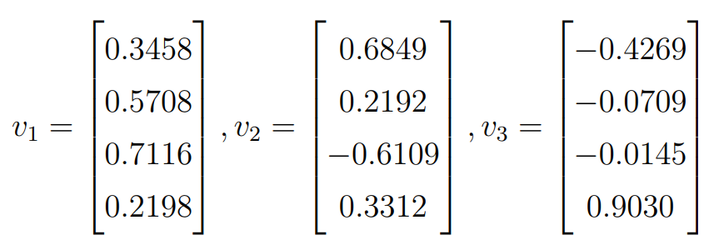

Slide 7

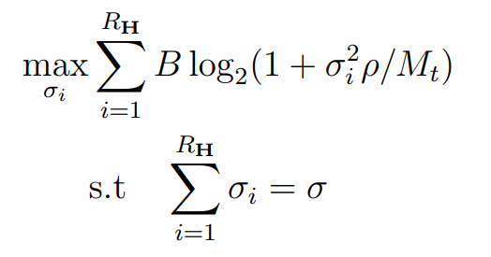


Concave: local optimal is global optima
the bound must be obtained to get max throughput.
Equal $σ_{i}$
monotone

